Slide 1
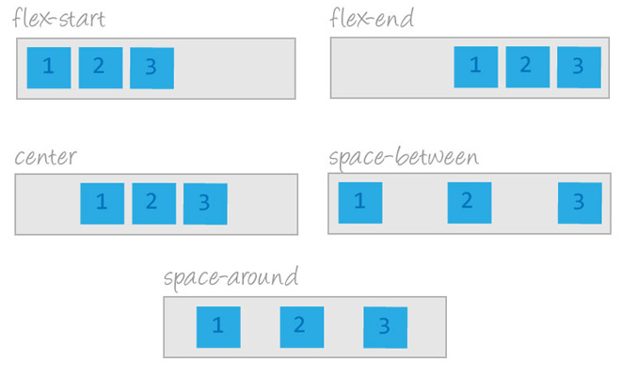
Flexbox
By: Shaylee Hansen
Notes:
Make sure to expand the notes panel ☺

Slide 2




WHOAmi?
Fall 2015 Cohort V School graduate
Member for GDI and Co-organizer of PyladiesSLC
@HansenShaylee
www.shayleehansen.com
Notes:
Who am I and why do I want to talk to you about Flexbox.
First things first my name is Shaylee Hansen. I graduated from V School in the winter of 2015 in Python Web Development. Since graduating from V School I have found employment as Jr Front End Developer in Park City, Interactive Developer intern in Salt Lake and currently ... I'm an active member of Girl Develop IT, which is an organization that provides education and support for women interested in coding. Recently I have re-activated the PyladiesSLC as a co-organizer.
So why do I want to talk to you about Flexbox? Well I wanted to share my knowledge with you today in hopes of providing you with a better understanding of CSS then I had when I started out as a junior dev. When you first start out there are so many things you are required to know and it can be hard to figure out what it is you really need to know. Well today I am here to tell you, Flexbox is definitely one of those things you will want to know.
Disclaimer: I do not consider myself a Flexbox master. I’m just another junior developer like yourselves sharing what I have learned to help make your life easier. So today's discussion is by no means a comprehensive guide but more of a general overview to get you familiar with and excited to use Flexbox
First, I will start out by going over what Flexbox is and why we should use it. After that I will explain the in’s and out’s of Flexbox by providing coding samples through demonstration.( I will be using CodePen if you would like to follow along) I will end with providing you a few links to resources on Flexbox.

Slide 3
According to the Mozilla Developer Network CSS3 Flexible Box or flexbox is a layout mode providing for the arrangement of elements on a page such that the elements behave predictably when the page layout must accommodate different screen sizes and different display devices.
Flexbox?
“CSS Tricks says Flexbox aims at providing a more efficient way to layout, align and distribute space among items in a container, even when their size is unknown”
Notes:
Flexbox: - Make sure to click to make bubbles appear
Have you ever tried to align elements in CSS and found it to be very challenging and more of an effort then you expect? What about creating a navigation bar without using Bootstrap? Or trying to make your webpage responsive. If so, I empathize with you. I’ve been in your shoes and have spent countless hours trying to create perfectly aligned nav bars, text and images that appear perfectly aligned. Not to mention making sure everything on my web page is responsive from mobile all the way up to desktop. It can be quite the feat.
Well I’m here to tell you that this problem has been solved, and been solved through CSS. Yes you heard right CSS has properties that will allow you to align elements as well as keep them responsive with ease without relying on a framework to do so. These new properties are called the Flexbox layout. Like I stated before the main idea behind the flex layout is to give the container you are styling the ability to alter its items based on their height, width and order to best fill the available space in AND…. here it comes ….to accommodate to all kinds of displays and devices. So what does this mean? It means all of those pesky problems you ran into with trying to align elements just so, as well as making them responsive has just become a lost easier. Say goodbye to using tons of media queries and say hello to Flexbox.

Slide 4
I’m sold, how do I get started?
Set the display property to:
.parent-container{
display: flex;
}
// display flex on the parent HTML element
https://codepen.io/monkeymohawk/pen/EgdqYa?editors=1100
Notes:
Ok, I’m sold, so how do I get started?
We will start with the creating a .parent-container class which we will then apply the property display with the value of flex.
This activates the container so we are able to use the rest of the display properties.

Slide 5
flex-direction
.parent-container {
display: flex;
flex-direction:
}
row, column, row-reverse, column-reverse
https://codepen.io/monkeymohawk/pen/EgdqYa?editors=1100
Notes:
After you set the display you then need to decide what direction you want your elements to go.
Do you want them to align horizontally ( in a row ) or vertically (in a column )?
Some things to note:
In Flexbox the row is automatic by default so you don’t need to declare flex-direction: row unless you really want to.
You can also choose to display your column or row in reverse order by including row-reverse or column-reverse.

Slide 6
justify-content
Think – ROW –
.parent-container{
display: flex;
justify-content:
}
flex-start, flex-end, space-between, space-around, center
https://codepen.io/monkeymohawk/pen/EgdqYa?editors=1100
Notes:
Justify-content
- Defines alignment along the main axis. Think left to right, like a hot dog fold
Works in conjunction with the property flex-direction: row
Includes five properties: flex-start, flex-end, space-between, space-around, center

Slide 7
align-items
Think – COLUMN –
.parent-container{
display: flex;
align-items:
}
flex-start, flex-end, center, baseline, stretch
https://codepen.io/monkeymohawk/pen/EgdqYa?editors=1100
Notes:
- Default behavior for how flex-items are laid out along the cross axis of the current line. Think top to bottom. Like a hamburger fold.
Works in conjunction with the property flex-direction: column
Includes five properties: flex-start, flex-end, center, baseline, stretch

Slide 8
align-content
.parent-container{
display: flex;
align-content:
}
flex-start, flex-end, center, space-between, space-around, stretch
Notes:
-Applies to multi-line flex containers. So when there is only one line of flex items the property will have no effect.
-This can be confusing, but align-content determines the spacing between lines, while align-items determines how items as a whole are aligned within the container. When there is only one line, align-content has no effect.

Slide 9
flex-wrap
.parent-container{
display: flex;
flex-wrap:
}
wrap, no-wrap, wrap-reverse
https://codepen.io/monkeymohawk/pen/EgdqYa?editors=1100
Notes:
By default flex items will try to fit onto one line as you saw early.
That can be changed to allow items to wrap as needed within the property
Includes three property values: wrap, no-wrap, and wrap-reverse
If wrapping is allowed it also enables you to control the direction in which lines are stacked.
Note to self: On code pen maximize and minimize browser.

Slide 10
order
.parent-container{
display: flex;
}
.child-element{
order:
}
Integer ( -1, 0, 1, 2 )
https://codepen.io/monkeymohawk/pen/EgdqYa?editors=1100
Notes:
What to know:
-You can only use the order property on the child element of the parent container.
Flexbox can be reordered with this simple property without restructuring the
code.
Things to remember:
Source order is based off the way the elements are laid out in the source aka HTML.

Slide 11
align-self
.parent-container{
display: flex;
}
.child-element{
align-self:
}
flex-start, flex-end, center, baseline, stretch
https://codepen.io/monkeymohawk/pen/EgdqYa?editors=1100
Notes:
Just like the order property it only applies to children elements of the parent container.
Overrides the property align-item’s values / Accepts the same values as align-items and its value for the specific item

Slide 12
flex-flow
.parent-container {
display: flex;
flex-flow: column wrap;
}
flex-direction and flex-wrap properties combined.
https://codepen.io/monkeymohawk/pen/EgdqYa?editors=1100
Notes:
Because flex-direction and flex-wrap are used so often together a shorthand property flex-flow was created to combine them.

Slide 13
Resources
&
Links

Slide 14
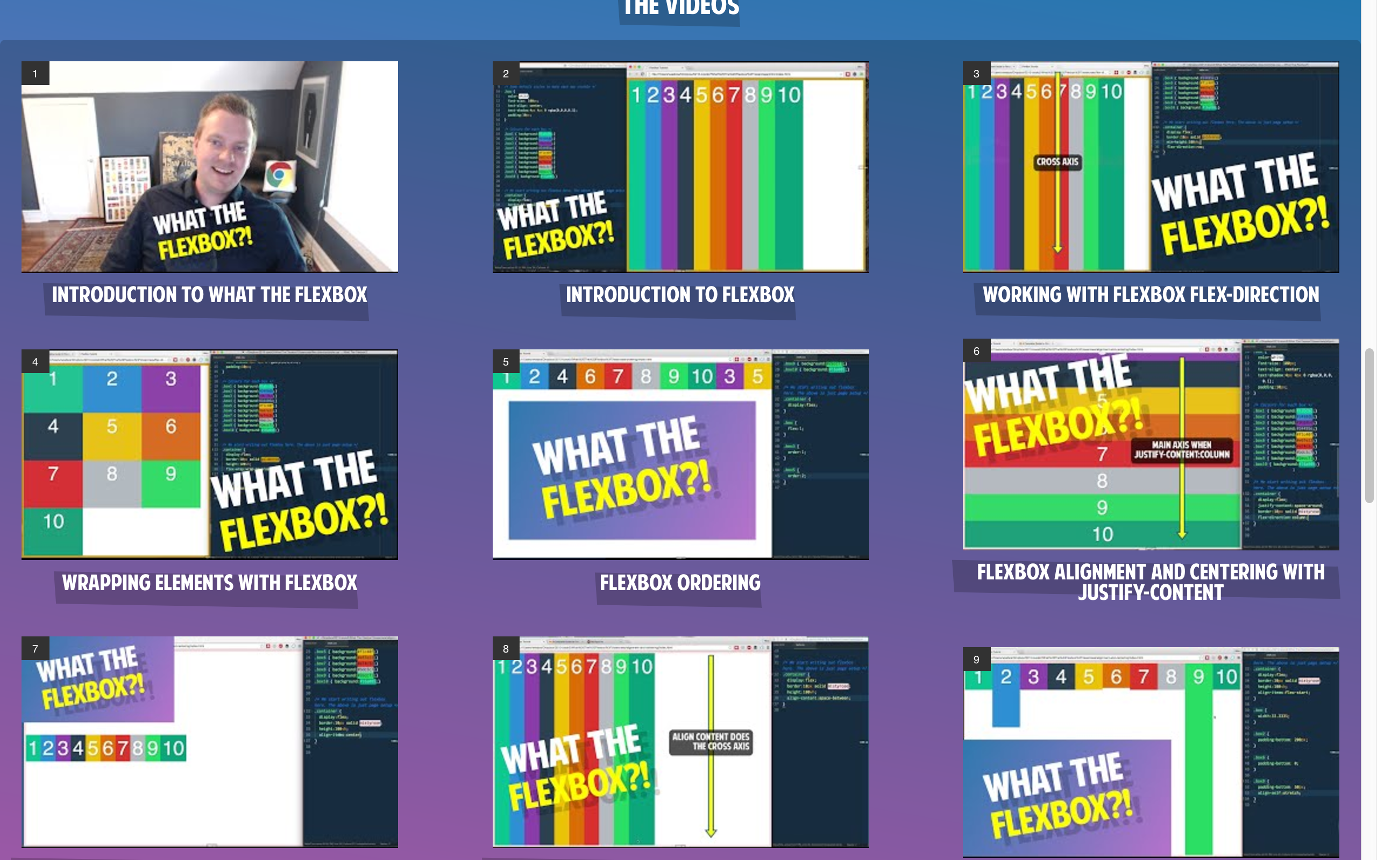
WES BOS
https://flexbox.io/
Notes:
Wes Bos is this Canadian fellow who is the lead instructor at HackerYou and is involved with the Ladies Learning code where he teaches WordPress. He has created several online courses some from Mastering Sublime Text to Es6. I think he is awesome. I initially got into Flexbox through running into this course via the interw-ebs. Check out his videos they are free.

Slide 15
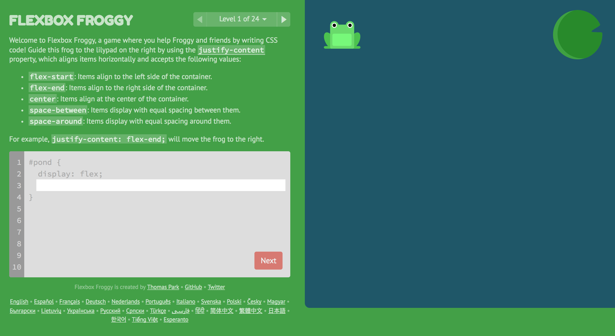
Flexbox Froggy
http://flexboxfroggy.com/
Notes:
Next we have Flexbox Froggy. Again found this when I was learning all about Flexbox and thought it was a fun way to learn the Flexbox concepts.

Slide 16
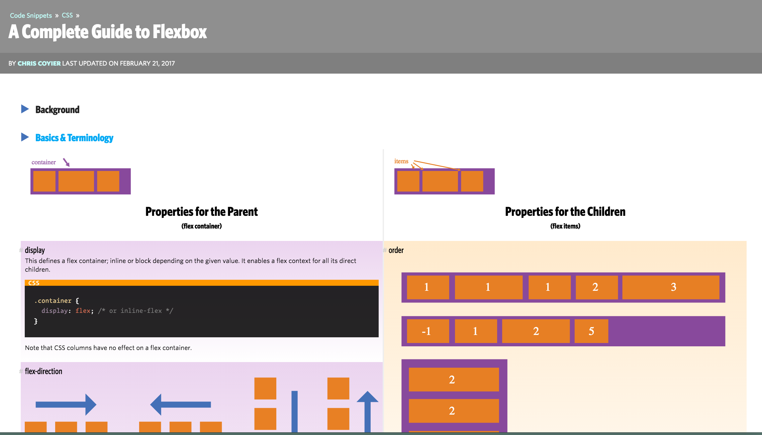
CSS-Tricks: A Complete Guide to Flexbox
https://css-tricks.com/snippets/css/a-guide-to-flexbox/
Notes:
Finally we have CSS-Tricks: A Complete Guide To Flexbox. I have this bookmarked and use it regularly It goes into the background behind Flexbox as well as provides you with visuals of how to use the properties in your code. If you haven’t yet checked out CSS-Tricks I highly recommend it.

Slide 17
Thank You
Check out my blog: www.shayleehansen.com
Follow me on Twitter: @HansenShaylee

